Slide 1

Predicting Negative Mental Health Outcomes in Gamers
Anith Muthalaly
Fyrooz Anika Khan
Stephen Davanzo

Slide 2

Agenda
Introduction
EDA
Relevant Tests & Findings
Linear Regression
Logistic Regression
Random Forests
Key Takeaways

Slide 3
Introduction
Data
13,464 gamers from 109 countries
Generalized Anxiety Disorder (GAD), Social Phobia Inventory (SPIN), Satisfaction With Life (SWL)
Research Proposal
Use regressor and classification model to predict mental health outcomes based on gaming habits and certain demographic information. When possible, inference which variables contribute the most.

Slide 4
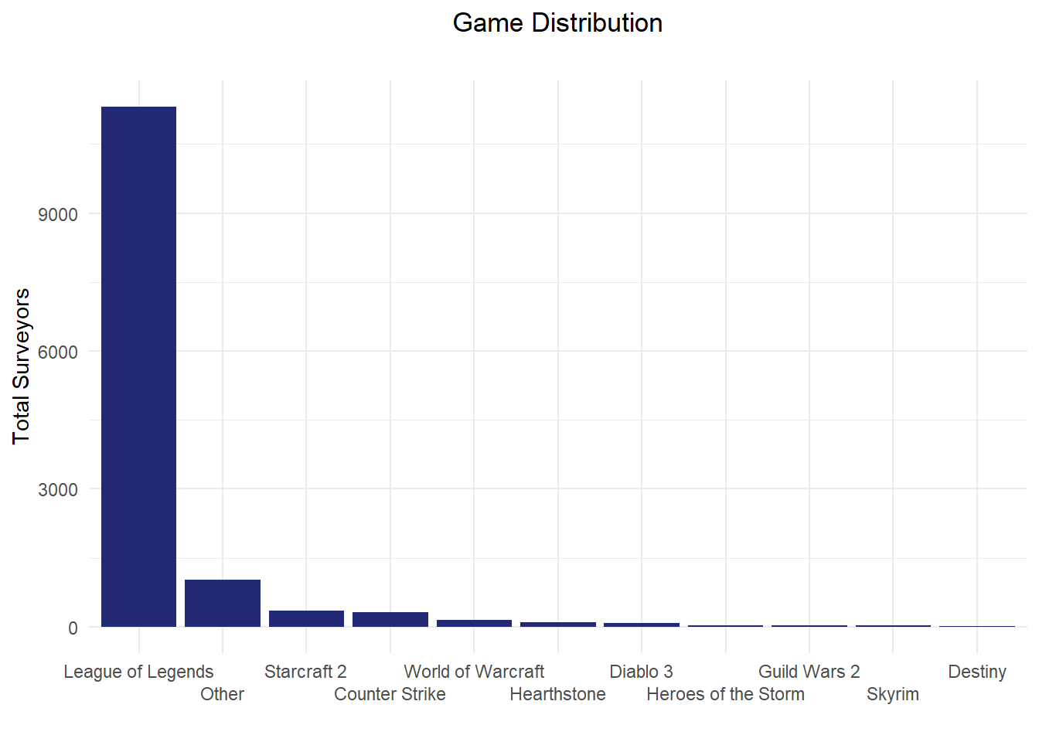
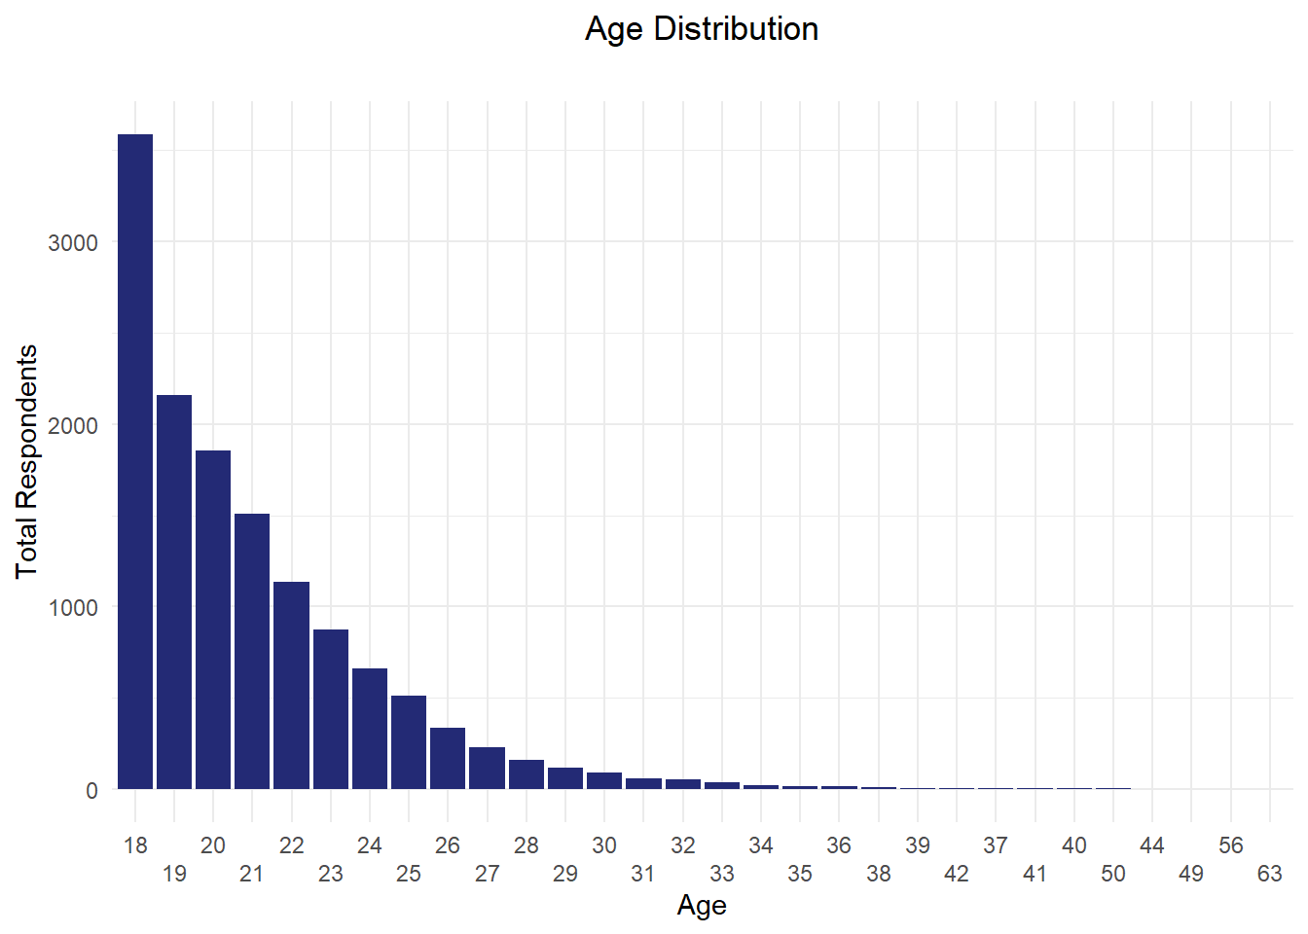
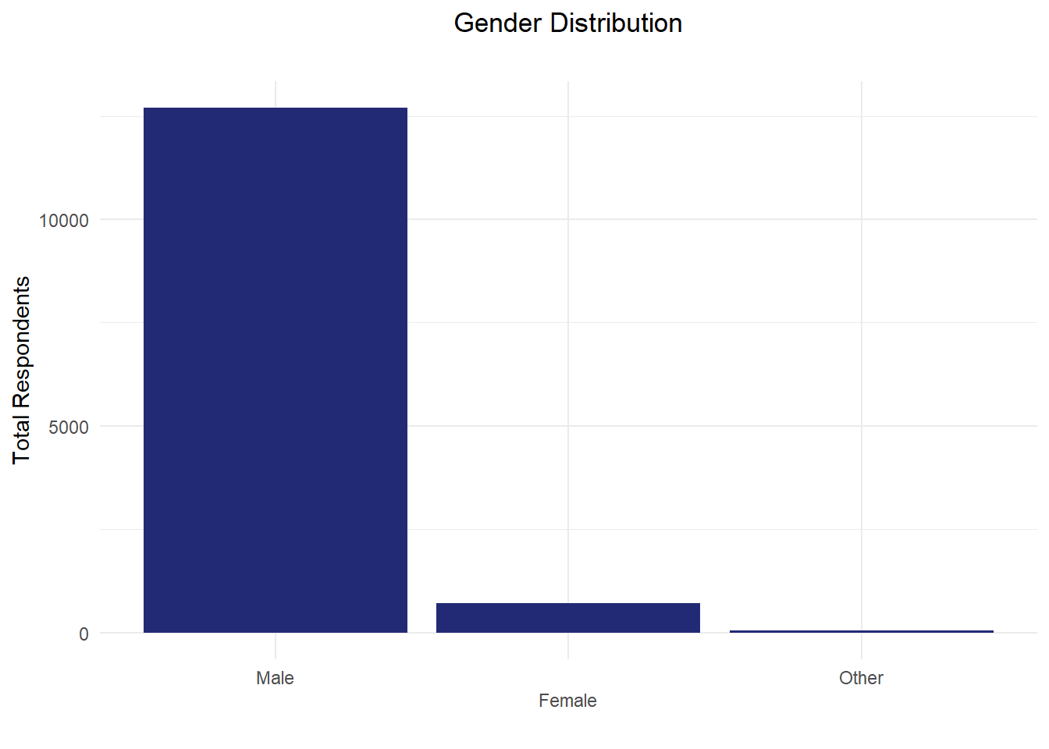
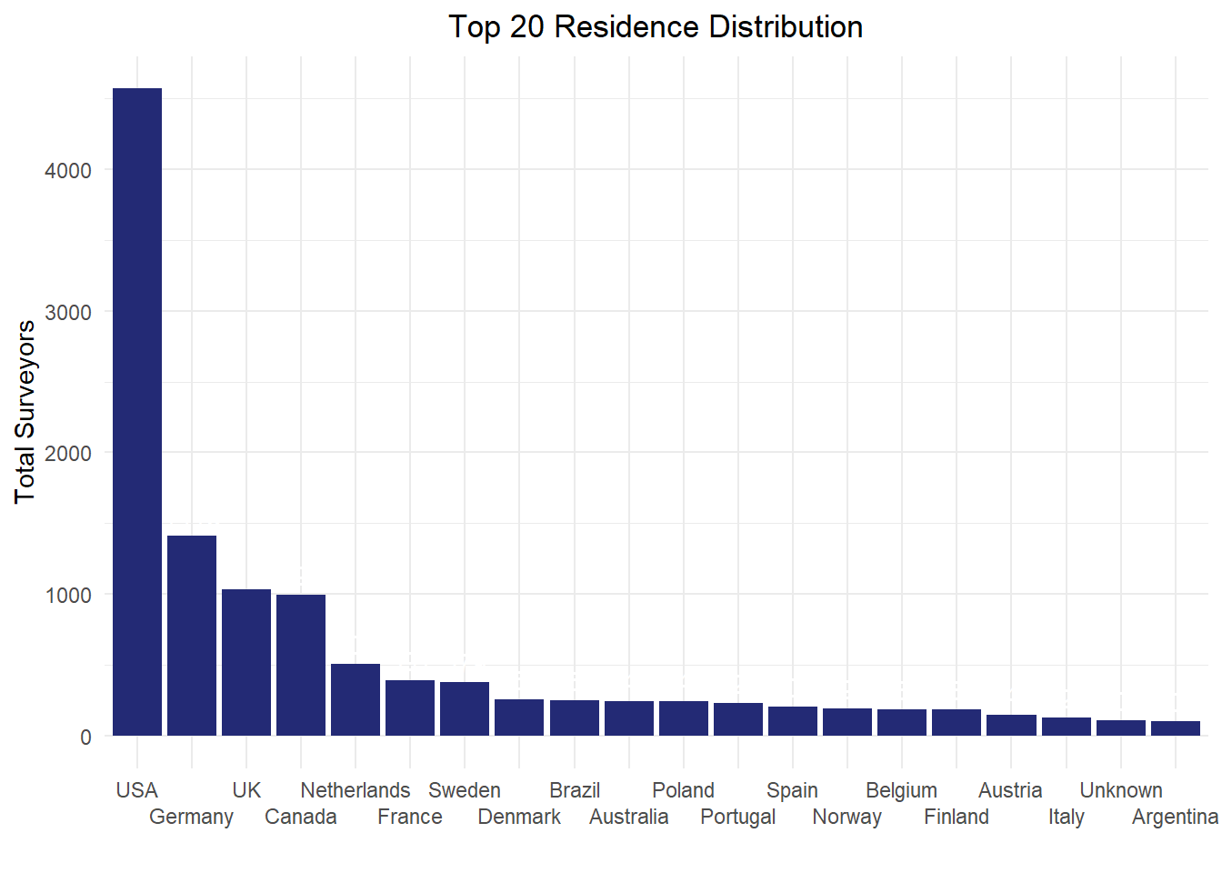
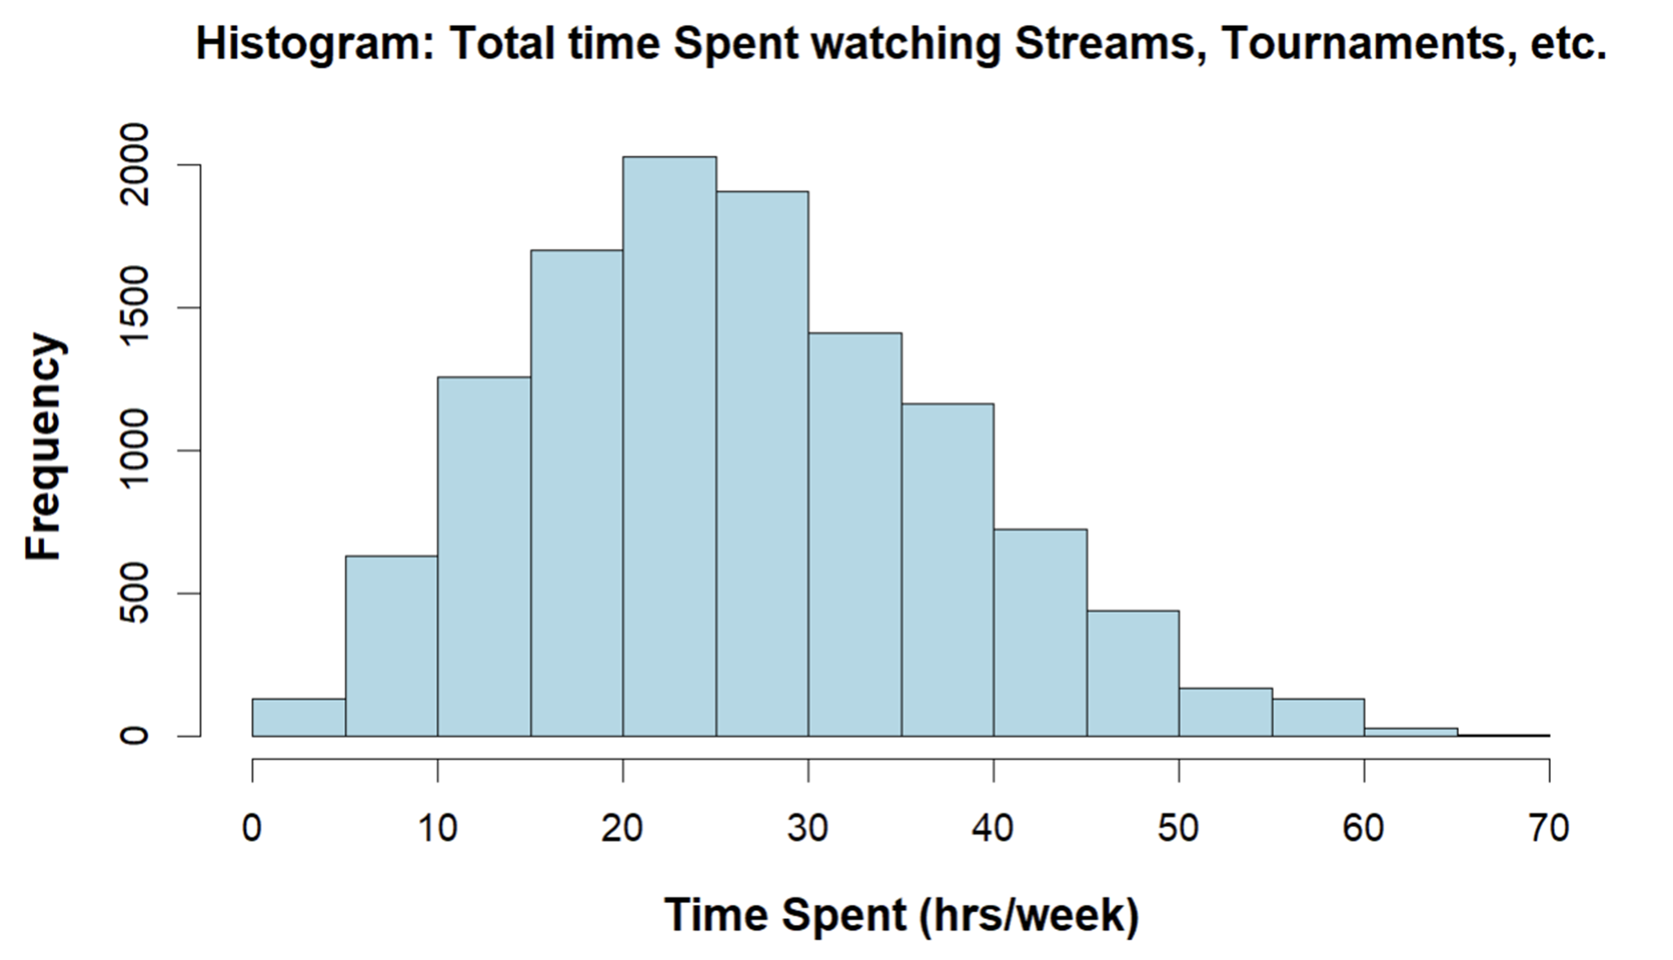
SOME KEY FINDINGS FROM EDA
Age
Gender
Residence
Game
Time

Slide 5
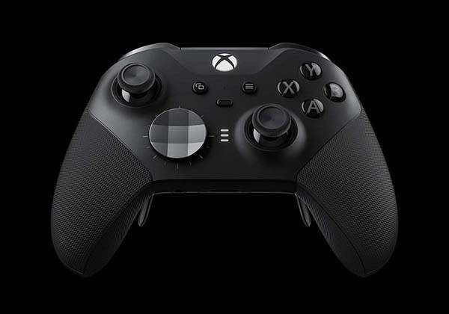
relevant Key Findings from project1
Hours spent playing video games affects how much time is spent streaming.
There is a significant effect on hours played and mental health outcomes.
Gamers who play for “fun” have better mental health outcomes; those who play for “winning” and “escaping” do not.

Slide 6
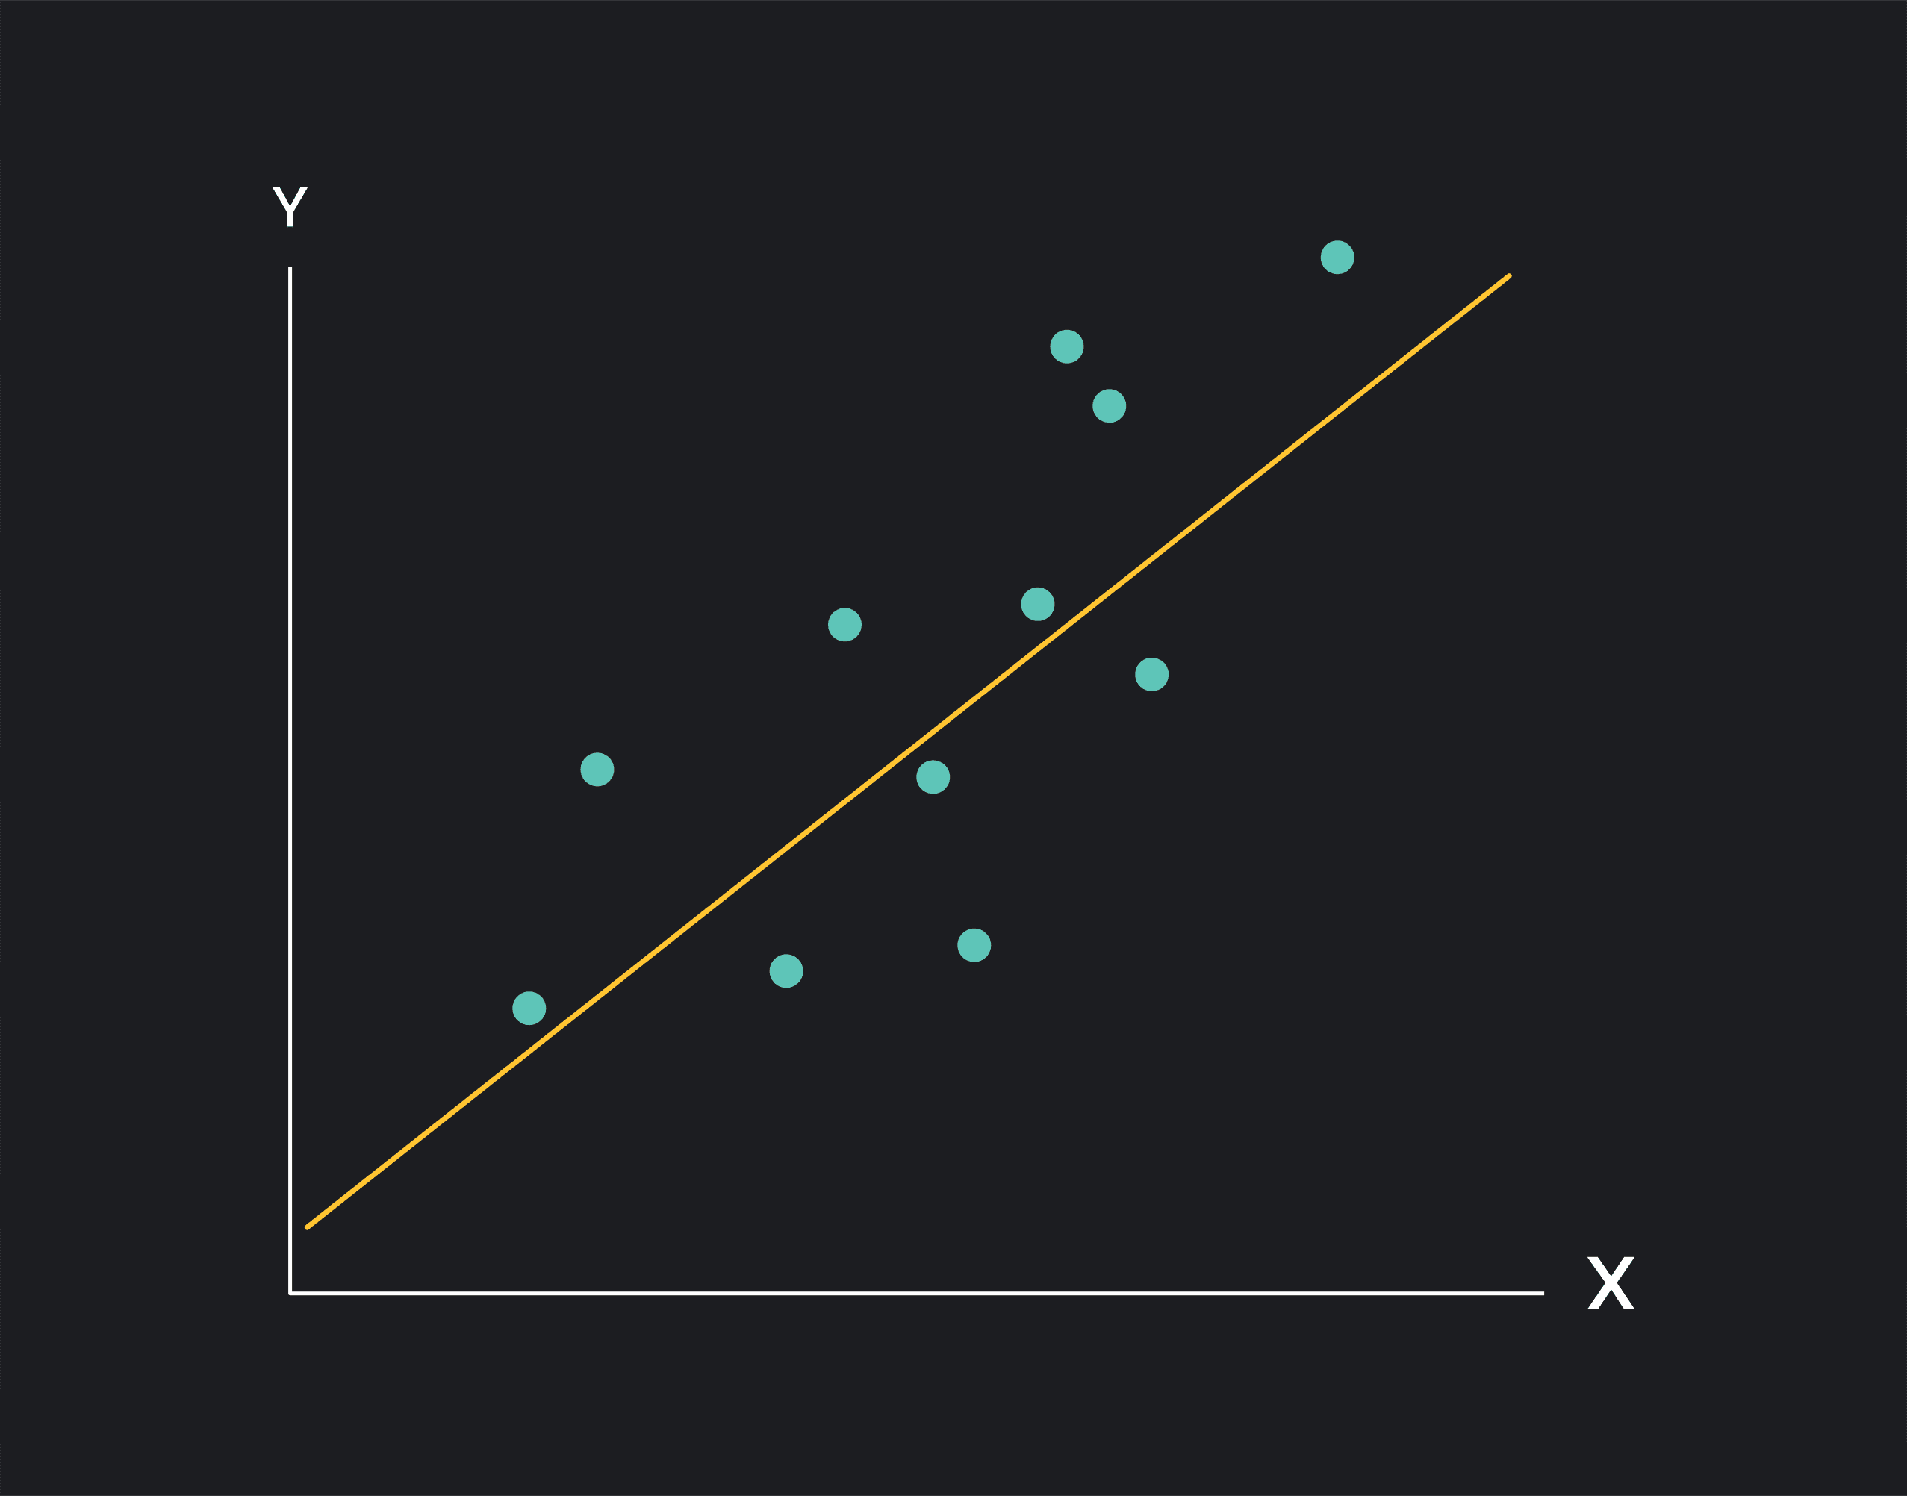
Linear regression

Slide 7
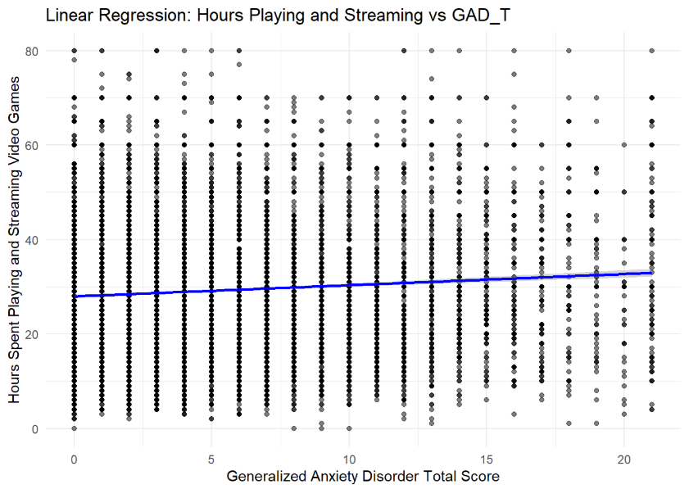
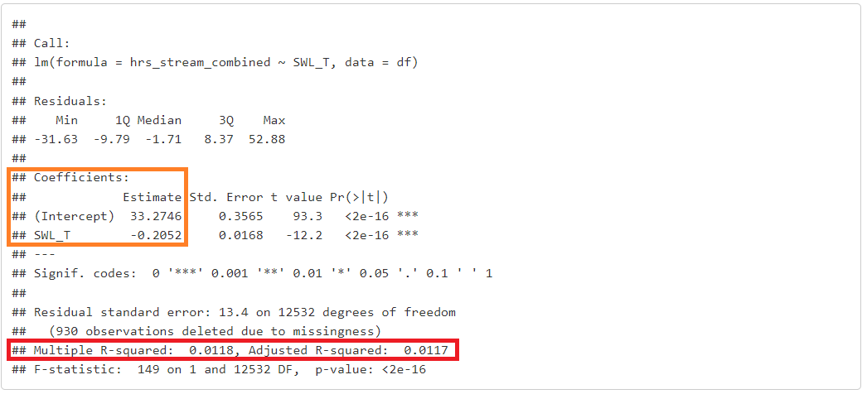
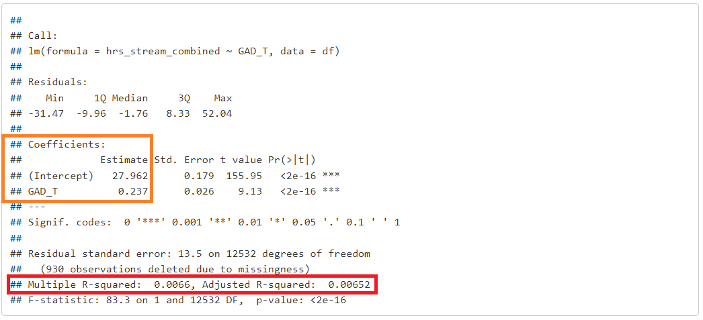
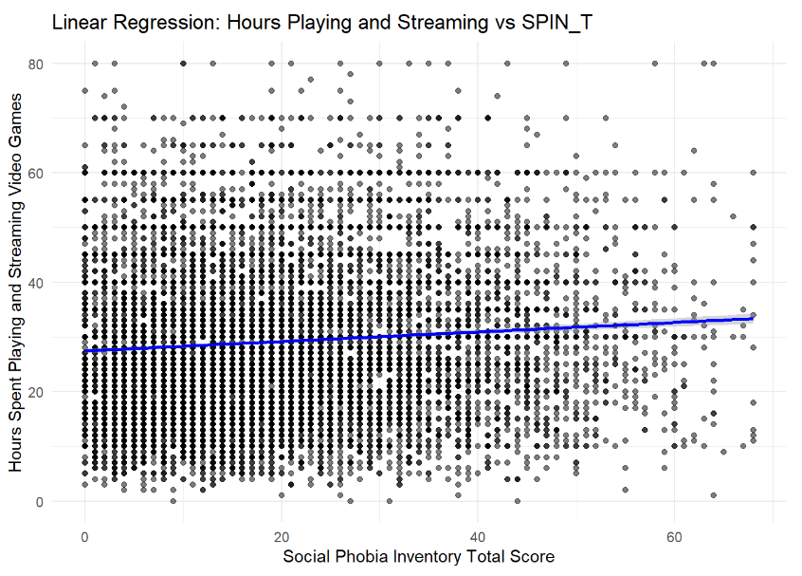
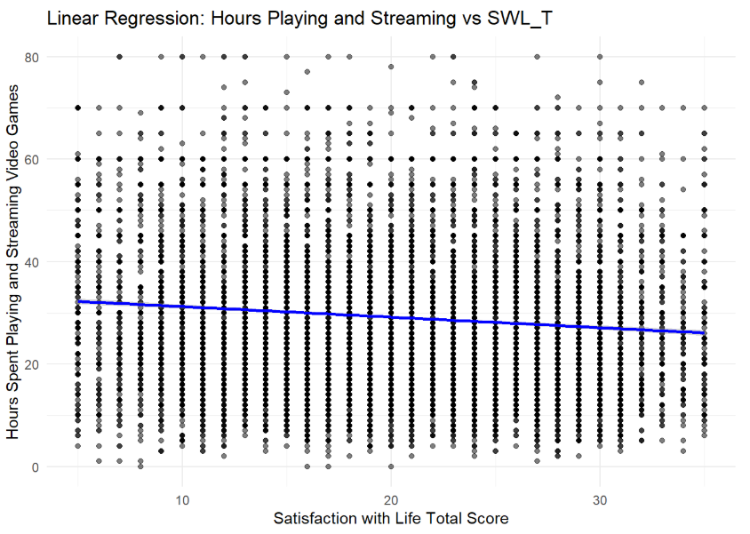
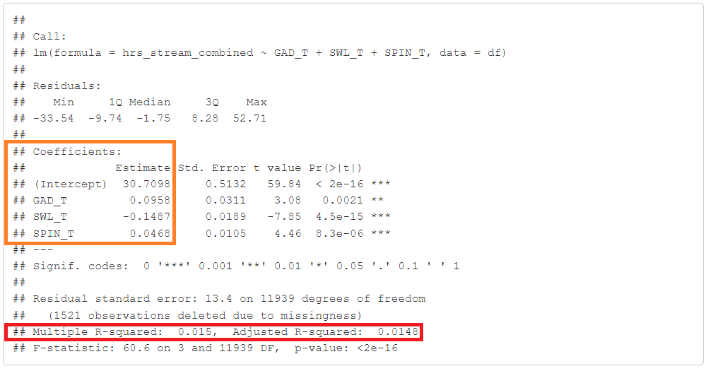
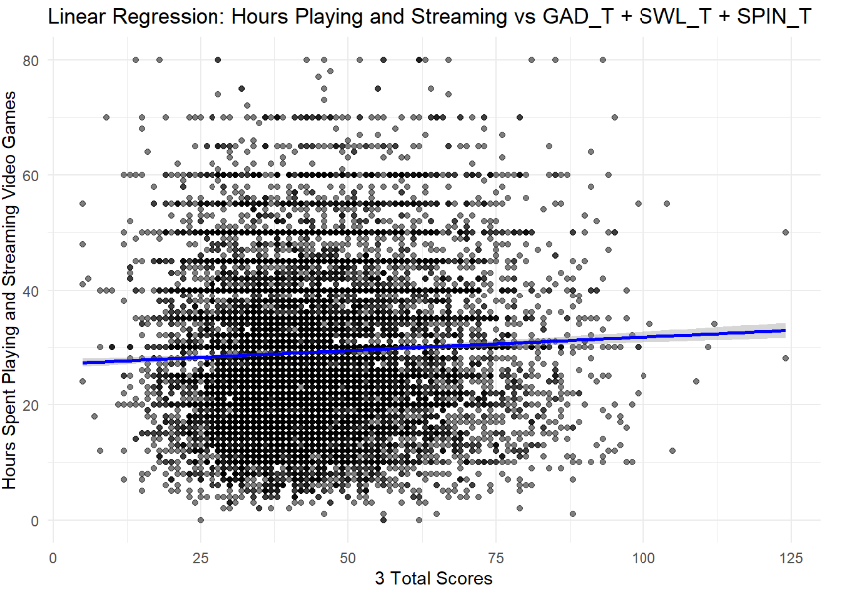
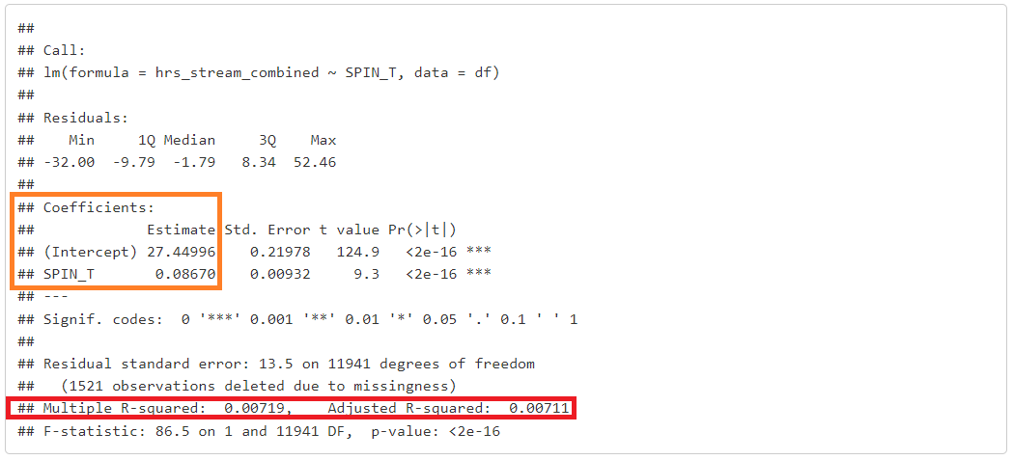
Numerical models
Predictor
hrs_stream_combined
Regressors:
GAD_T
SWL_T
SPIN_T

Slide 8
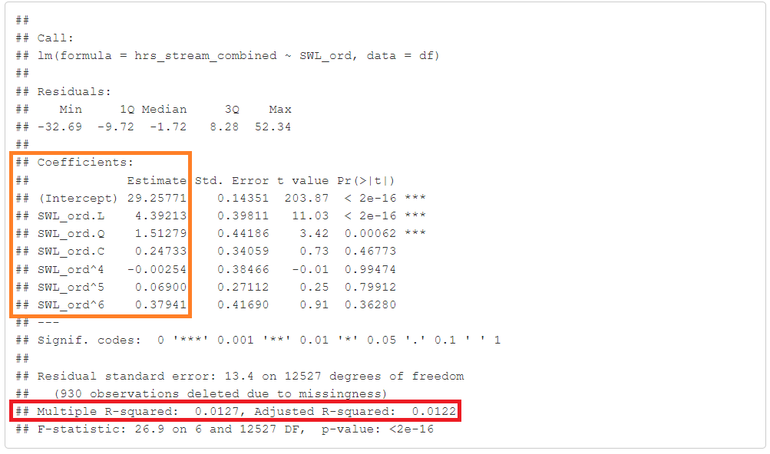
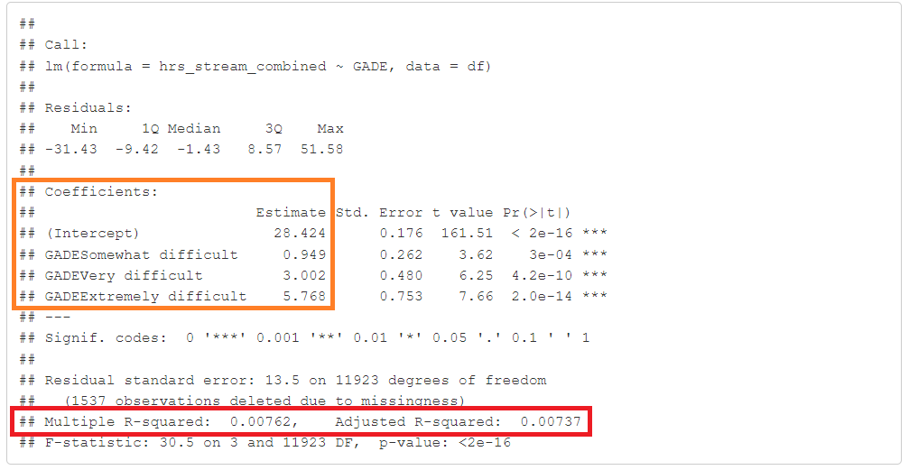
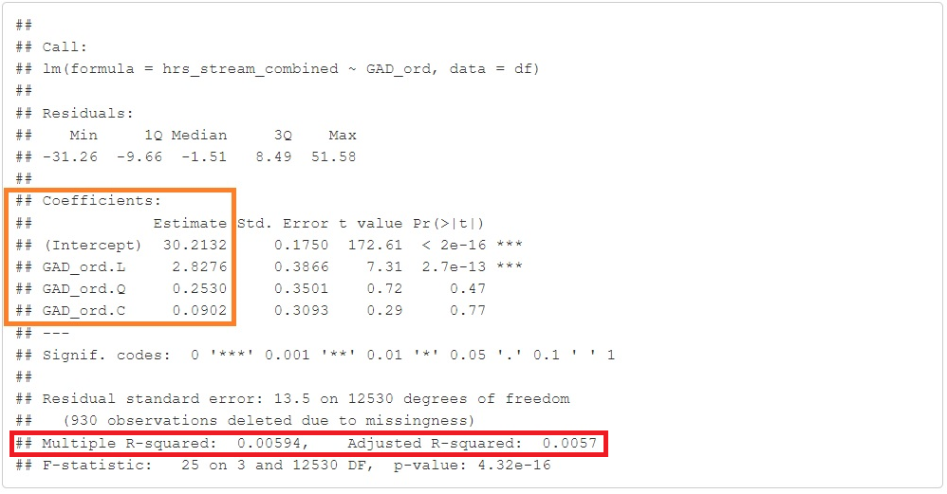
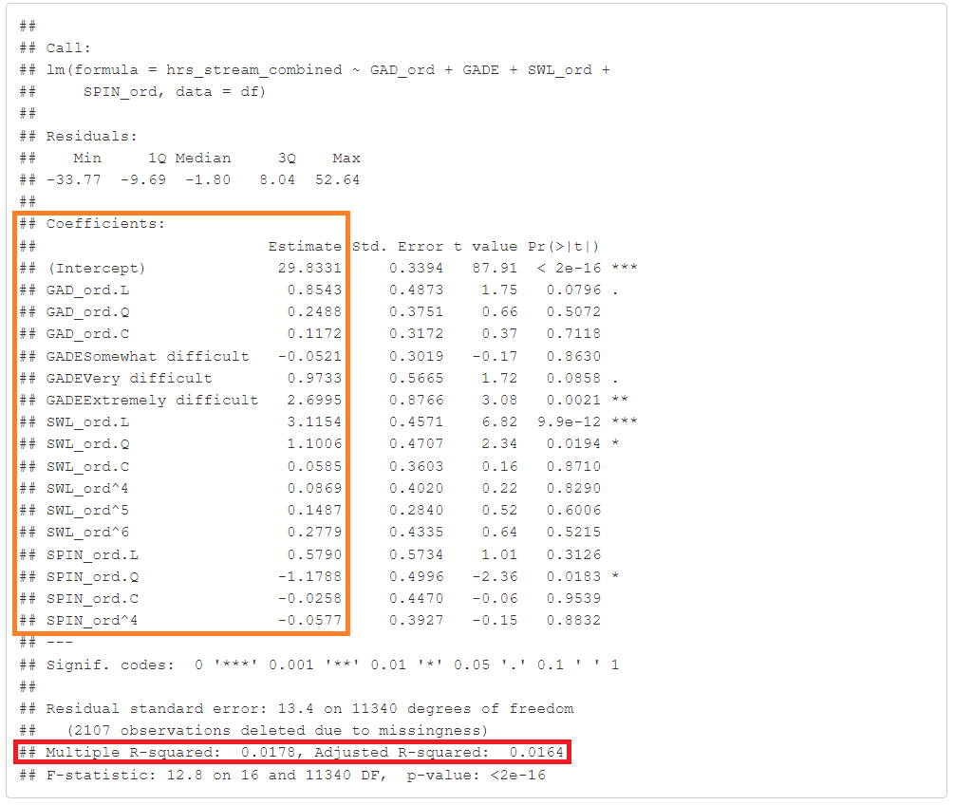
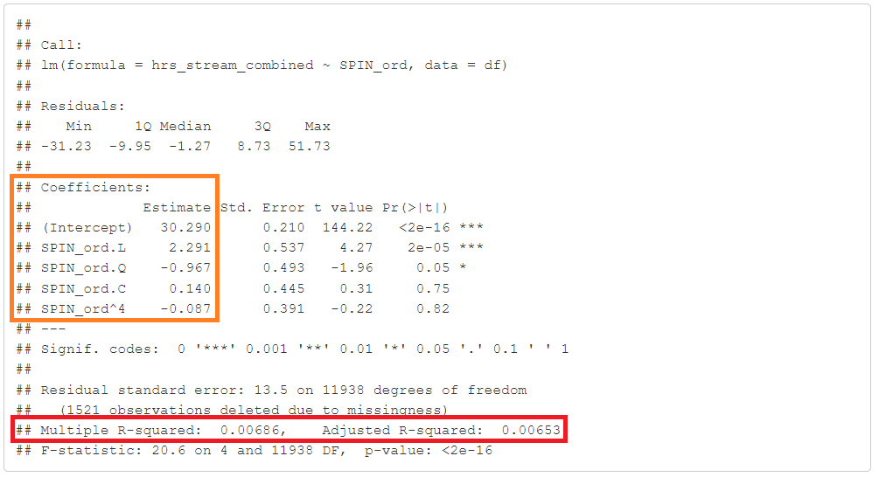
Ordinal models
Predictor
hrs_stream_combined
Regressors:
GAD_ord
GADE
SWL_ord
SPIN_ord

Slide 9
Logistic Regression

Slide 10
Logistic Regression for Predicting Screen Time
Objective: To predict whether combined hours spent on gaming and streaming exceed 15 hours/week
Dependent variable: Hours spent (1 if played > 15hr/week, 0 otherwise)
Independent Variables: ​
SPIN_ord (factored)​
SWL_ord (factored)​
GAD_ord (factored)
Work (factored)​
Gender (factored)
Game (factored)​
Platform (factored)​
GADE (factored)​
Why_play (factored)
Age
T-test (Age) and Chi-square Tests (rest of the variables)

Slide 11
Logistic Regression for Predicting Screen Time
Assumptions of Logistic Regression
Linearity of the Logit:​
Linear relationship with the logit: Age_logit
Solution: Quadratic term for (Age^2)
Developed 3 models (Interaction with Age_log, Polynomial (Age & Age²), Splines (ns(Age, df=3))
Multicollinearity Check:​
 | Models | AIC | Comments
1 | Interaction with Age_log | 9672 | Identified non-linearity but retained potential collinearity.
2 | Polynomial (Age & Age²) | 9673 | Addressed non-linearity but introduced collinearity.
3 | Splines (ns(Age, df=3)) | ~9673 | Effectively captures non-linearity with reduced multicollinearity.

Slide 12
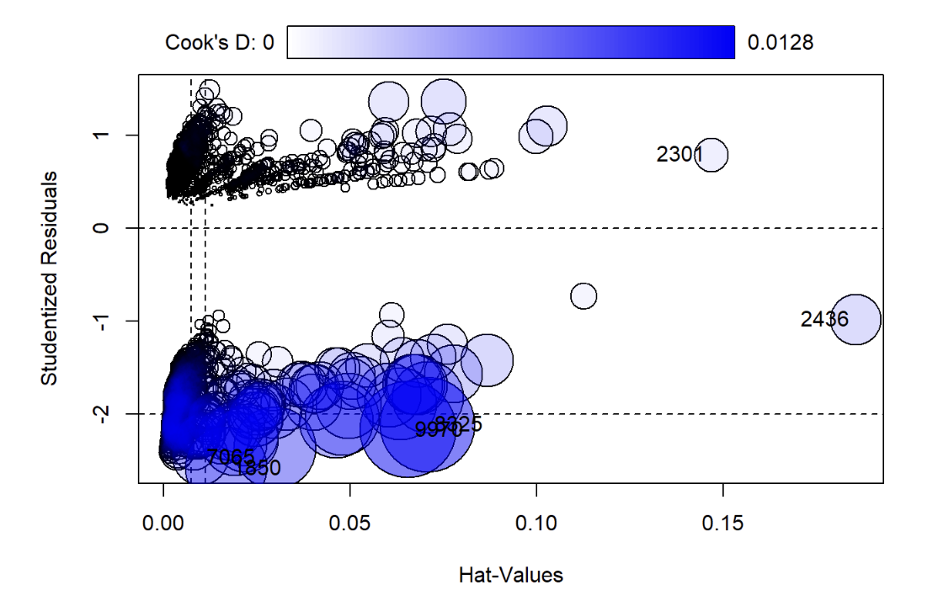
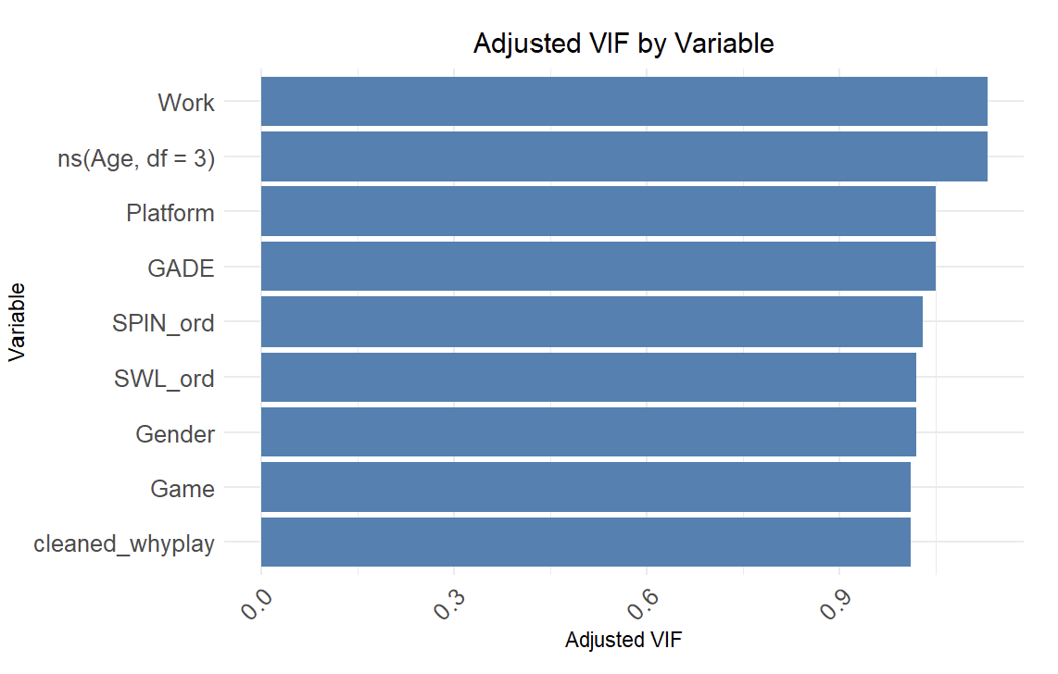
Logistic Regression for Predicting Screen Time
Assumptions of Logistic Regression
Influence of Strong Outliers
Leverage vs. Cook’s Distance Plot
Most data points show low leverage and
Cook’s distance.​
Conclusion:​
Assumptions are reasonably met.

Slide 13
Feature Selection: 3 Models
Predictors | Interaction with Age_log | Interaction with Age Quadratic Term | Spline Model
Significant Predictors
Age | Yes (p < 0.01) | Yes (p < 0.01) | Yes (p < 0.05)
Work (Unemployed/Between Jobs) | Yes (p < 0.001) | Yes (p < 0.001) | Yes (p < 0.001)
Gender (Male) | Yes (p < 0.001) | Yes (p < 0.001) | Yes (p < 0.001)
Game (Other, Starcraft 2) | Yes (p < 0.01) | Yes (p < 0.01) | Yes (p < 0.01)
Platform (PC) | Yes (p < 0.001) | Yes (p < 0.001) | Yes (p < 0.001)
Cleaned_WhyPlay (Relaxing) | Yes (p < 0.001) | Yes (p < 0.001) | Yes (p < 0.001)
Age_log | Yes (p < 0.01) | Not Applicable | Not Applicable
Age^2 | Not Applicable | Yes (p < 0.01) | Not Applicable
Spline (Age, DF = 3, Terms 2 & 3) | Not Applicable | Not Applicable | Yes (p < 0.05)
Non-Significant Predictors
SWL_ord | Borderline (p = 0.07) | Borderline (p = 0.07) | Borderline (p = 0.08)
Work (Students) | No | No | No
Gender (Other) | Borderline (p = 0.09) | Borderline (p = 0.09) | Borderline (p = 0.09)

Slide 14
Logistic Regression for Predicting Screen Time
LR Model Assessment: Confusion matrix, ROC-AUC values​
Overall Performance: ​
model demonstrates good predictive power
performs poorly in identifying the negative class
ROC-AUC and McFadden's Pseudo-R2 suggest modest model performance
Metric | Value
Accuracy | 0.84
Precision | 0.84047
Recall | 0.99853
F1 Score | 0.91354
Specificity | 0.00661
ROC-AUC | 0.638
McFadden's R2 | 0.0383
AIC | 9672
BIC | 9980

Slide 15
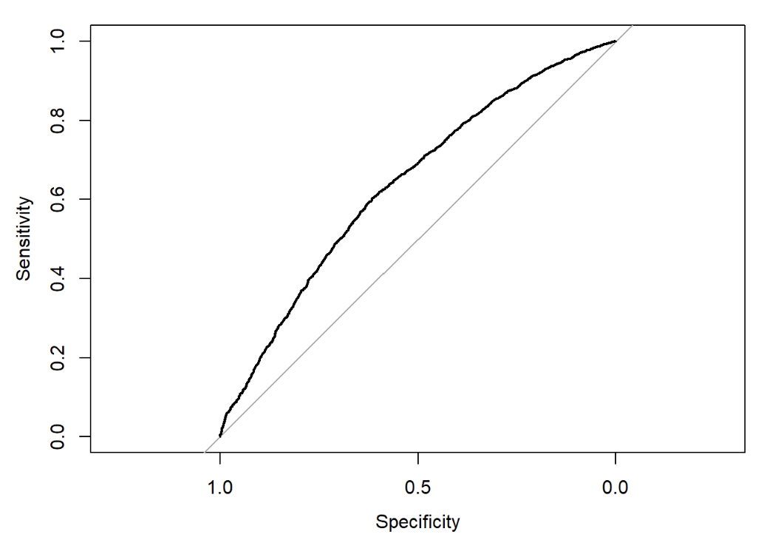
Logistic Regression for Predicting Screen Time
Adjusting the Cut-off Threshold
Optimal Cut-off: 0.839 (from ROC curve)
Performance at Optimal Cut-off:
Accuracy: 0.605 (60.5%)
Precision: 0.891
Recall: 0.603
F1 Score: 0.719
Better Balance Between Positive and Negative Classes

Slide 16
Random Forests

Slide 17
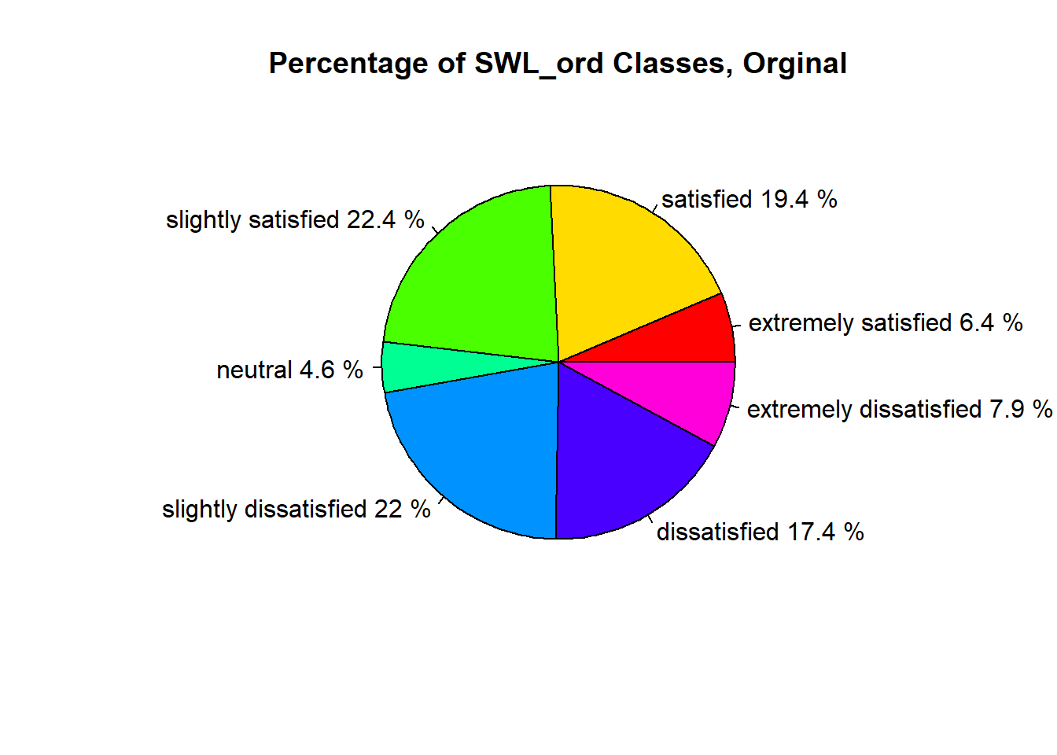
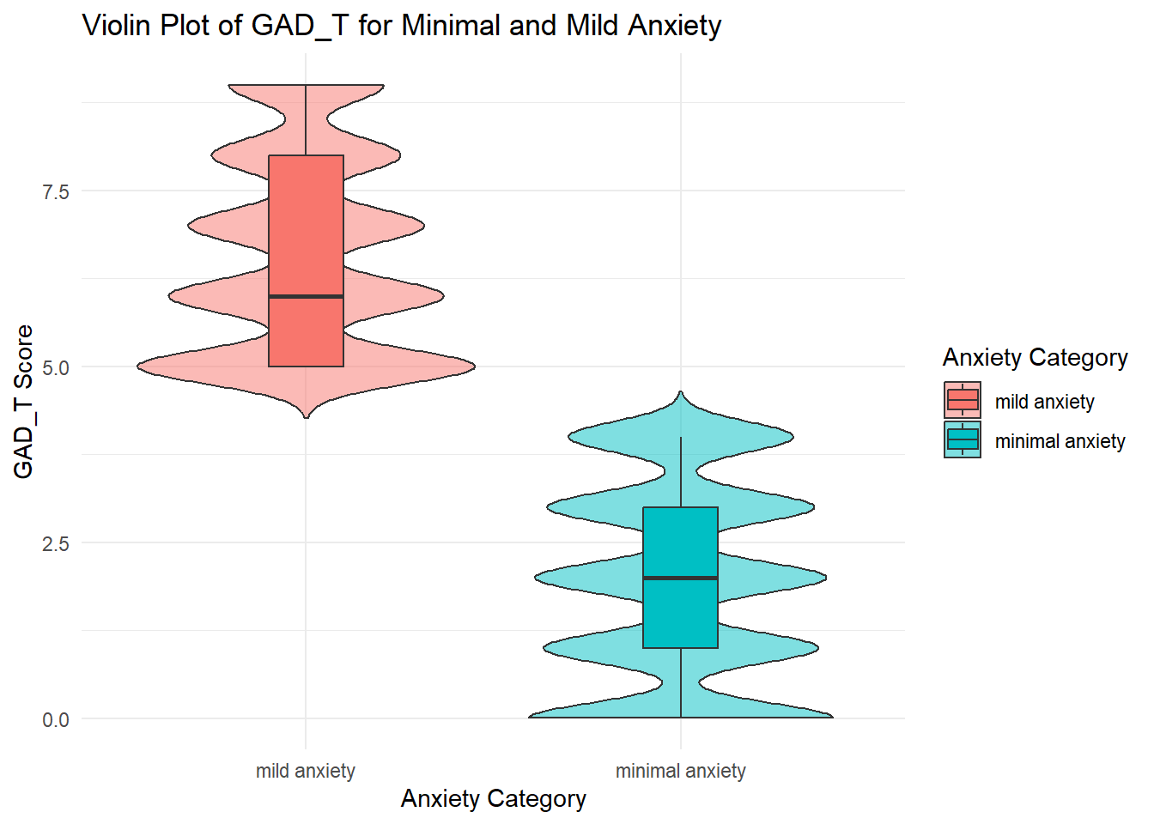

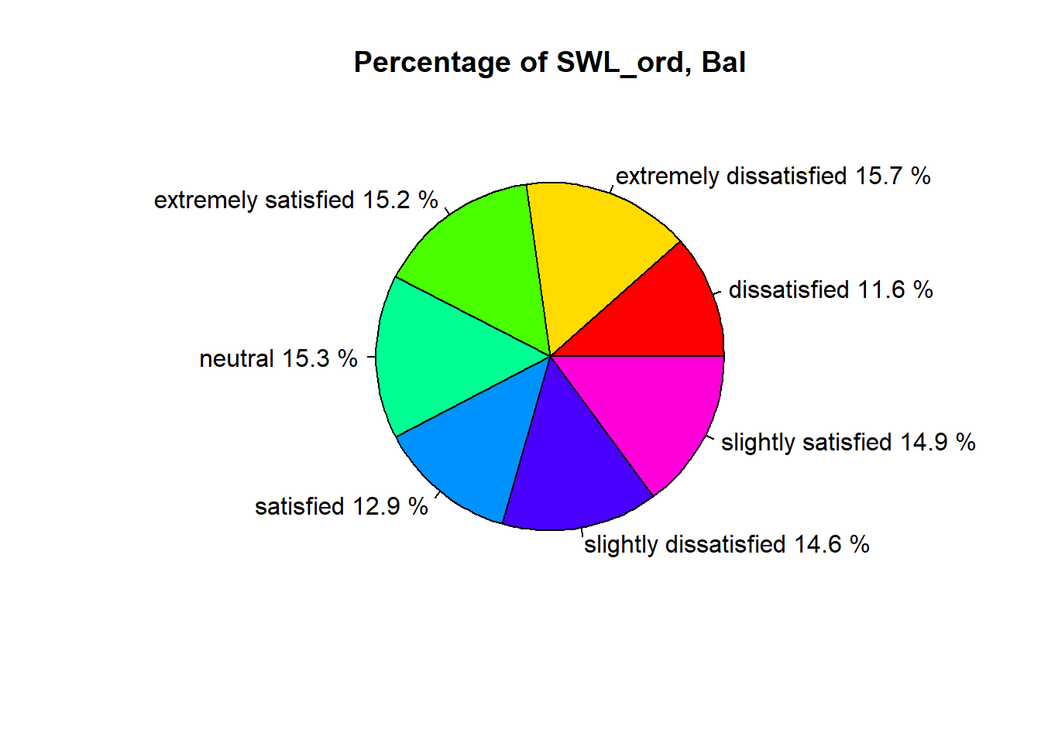
Random Forest – common steps
Class Balancing
SMOTE Parameter Tuning
Random Forest Hyperparameter Tuning – Grid Seach
Class Consolidation

Slide 18
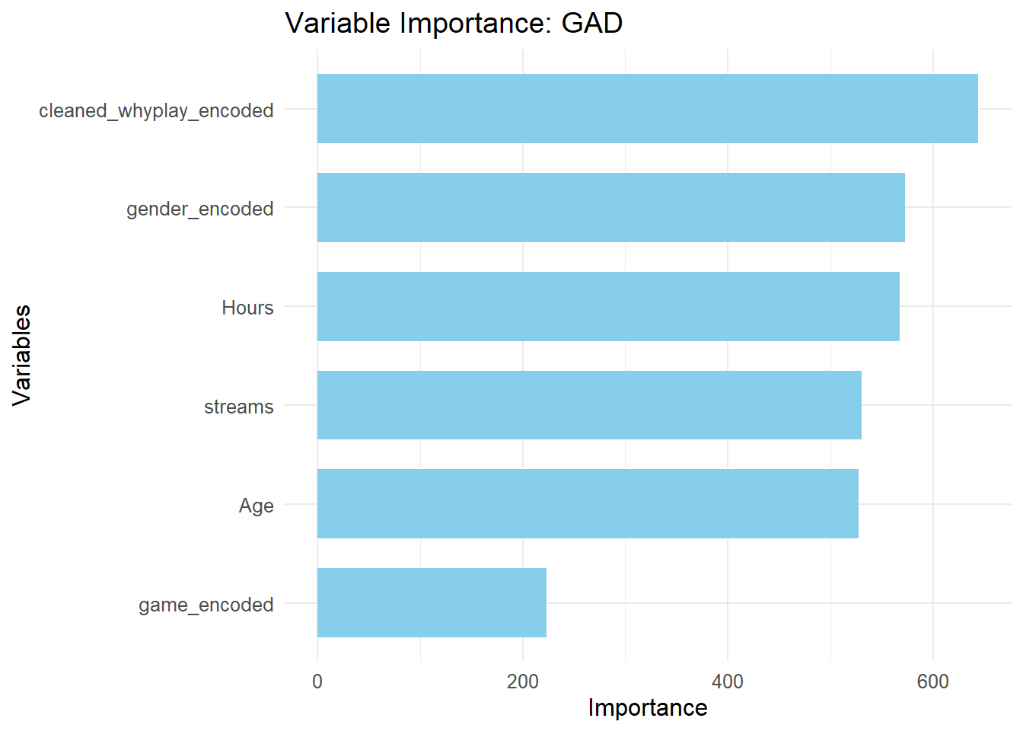
Random Forest -- GAD
Key Points:
~80% Accuracy
Mild and minimal anxiety consolidated
Strong precision for all classes
Incorrect classification of moderate class

Slide 19
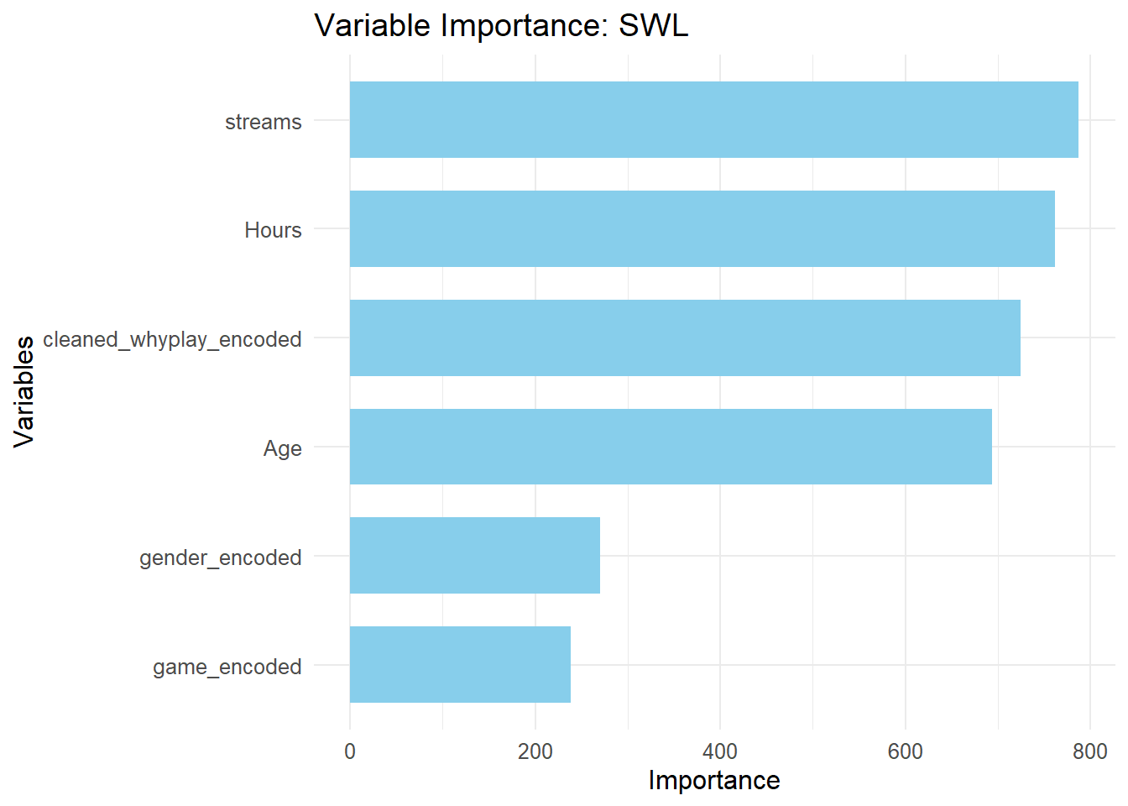
Random Forest -- SWL
Key Points:
~60% Accuracy
Dissatisfied and Slightly Dissatisfied consolidated
Satisfied and Slightly Satisfied consolidated
Weak performance on Dissatified_Slightly-Dissastified class (60% error)
Strong predicative ability on extreme ends

Slide 20
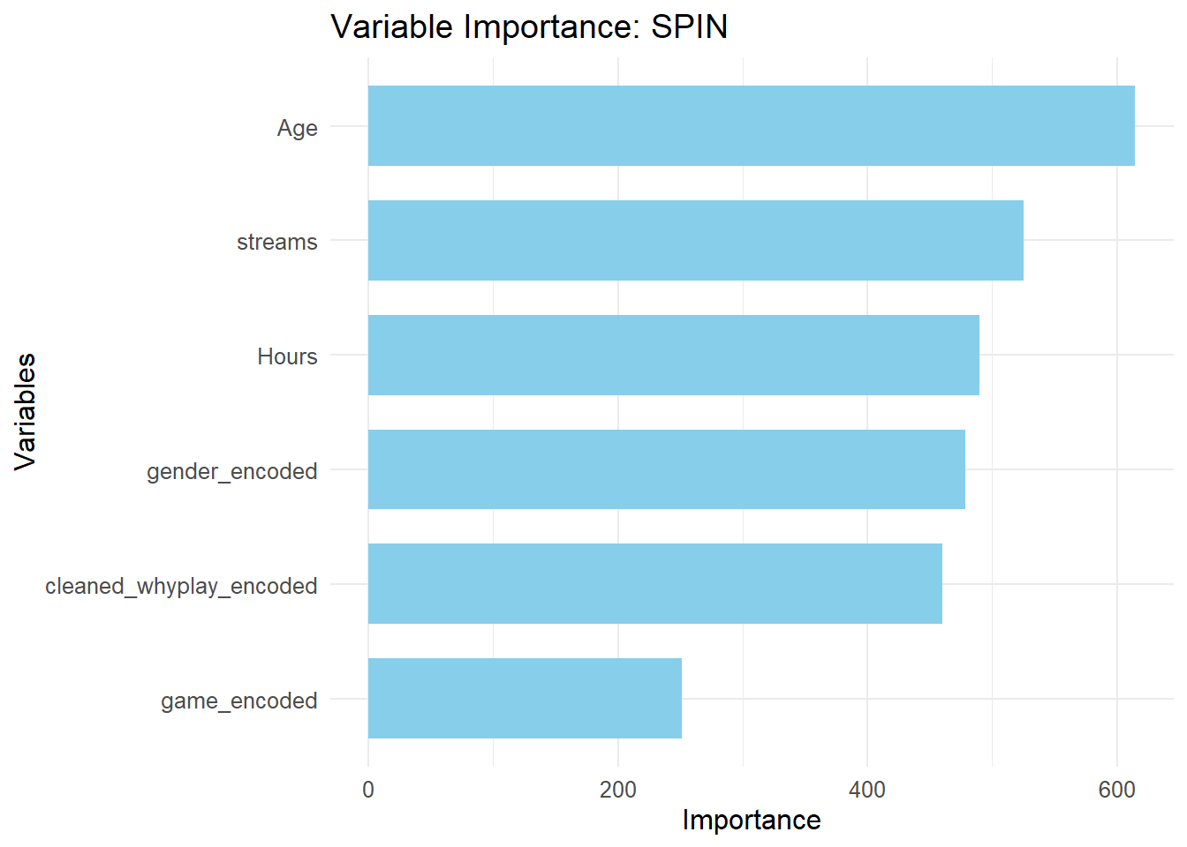
Random Forest -- SPIN
Key Points:
~60% Accuracy
Mild and Moderate consolidated
Most severe class has best overall class performance
High overall error rate
Weak predictive power for None and Mild-Moderate cases

Slide 21
Key takeaways
The relationship among hours playing and streaming video games to all psychological assessment scores and categories is not linear.
The adjusted model is quite good at predicting when gamers will have high screen time, making it reliable in most cases.
GAD is predictable using the available features. SWL and SPIN require more gaming habit/demographic features and greater engineering investment.

Slide 22

Thank you!

